Slide 1
Chapter 1
Week 2
Data Communications
and
Network Management Overview

Slide 2
Student Manual
Chapter 1 in Subramanian; Gonsalves & Rani (2010)
Sections
Chapter Overview
1.9
1.10
1.11
1.12
1.13
Chapter Summary
1.9 Network Management: Goals, Organization, and Functions 38
1.9.1 Goal of Network Management 38
1.9.2 Network Provisioning 39
1.9.3 Network Operations and NOC 39
1.9.4 Network Installation and Maintenance 41
1.10 Network Management Architecture and Organization 42
1.11 Network Management Perspectives 44
1.11.1 Network Management Perspective 45
1.11.2 Service Management Perspective 45
1.11.3 OSS Perspective 46
1.11.4 e-Business Management 46
1.12 NMS Platform 47
1.13 Current Status and Future of Network Management 47
Summary 48

Slide 3
PARTI
Background
Chapter 1 presents an overview of telecommunications, data communications, and network management.
It starts with an analogy of the telephone network. Telephone network almost always works, and there are reasons for its achieving quality and reliability. You will learn the relationship between data communications and telecommunications and how the distinction between the two is slowly disappearing. The influence of desktop computing and distributed computing environment based on client-server architecture has revolutionized computer communication. The Internet is a worldwide fabric and you will learn to appreciate how information travels across it around the globe. Basics of communication protocols and architecture are presented along with various standards. Select equivalent applications are used as illustrations comparing the Internet and OSI protocols.
Network management is more than just managing networks. Network management is presented from the perspectives of service management, operations support systems, and business management. The platform for a network management system is discussed based on client-server architecture.

Slide 4
Overview
This chapter demonstrates the necessity of network system and service management in providing information technology (IT) services.
The telephone system is known to be very reliable and dependable. One can make a telephone call from anywhere to anywhere at any time of the day and be reasonably sure that the connection will be made and the quality of connection will be good. This is partly due to the efficient management of the telephone network.
Section 1 .1 introduces the concept of management for the success of telephone network by using Operation Support Systems (OSSs).
Computer communication initially used the telephone network to carry digital data. There was a clear demarcation (fixing the boundary) between the traditional telecommunication network and computer communication network. Computer communication technology radically changed with the advent of desktop computing power and distributed computing environments (DCEs) using local area networks (LAN) as described in Section 1.3. Global communication using Internet became a reality with the introduction of TCP/IP- based networks.
The next phase the introduction of broadband services. Voice, video, and data could be delivered on the same medium to homes. It has also initiated improvement in the core wide area network (WAN).
Networking is full of "war stories" as experienced by IT managers.
Section 1.9 describes network management that comprises operations, administration, maintenance, and provisioning. Three groups perform these functions: Engineering, Operations, and Installation and Maintenance (l&M).
Section 1.10 focuses on Network Management System (NMS) and relationships between its various components. Besides managing network components, application system resources also need to be managed.
Network management technology is still in an evolutionary mode as network and software technologies advance. Section 1.12 briefly addresses NMS platforms based on Microsoft Windows and UNIX operating system.

Slide 5
Objectives
Chapter 1 Data Communications and NM Overview
Telecommunications overview
Data communications overview
Evolution of converged networks
Desktop processors and LAN technology
Client-Server architecture in networking
Internet and intranet
Network communication protocols
OSI and Internet standards
Broadband networks and services
Need for network management and NMS
Operations, Administration, Maintenance, and Provisioning
Network management architecture and organization
Concept of Network Operations Center
Perspectives of network management
Network management system
Look-ahead of network management technology
Network Management: Principles and Practice
© Mani Subramanian 2010
*
Notes:
*

Slide 6
ANALOGY OF TELEPHONE NETWORK MANAGEMENT
The need for data or computer communication network management is best illustrated by an analogy of telephone network management. It is reliable because it almost always provides service of voice communication that we expect of it. It is dependable because we can be fairly sure that it works when we need it. The quality of service is generally good; and we can have a conversation across the world with the same clarity that we have when we call our neighbor.
The present-day telephone network is referred to as Public-Switched Telephone Network (PSTN), The reason for such reliability, dependability, and quality is design, and implementation of a good telephone network using good and reliable components.

Slide 7
Chapter 1
Telephone Network
Modern network evolution from Telephone / Telecommunications Network
Characteristics of Telephone network:
Reliable - does what is expected of it
Dependable - always there when you need it (remember 911?)
Good quality (connection) - hearing each other well
Reasons for QoS :
Good planning, design, and implementation
Good operation and management of network
Migration to new technologies –
e.g., From analog to digital technology

Slide 8
Telephone Network Model
Chapter 1
The architecture of a telephone network is hierarchical as shown in Figure 1.1
There are five levels of network switches and three types of trunks that connect these switches.
A trunk is a logical link between two switches and may traverse one or more physical links. The end office (Class 5), which is lowest in the hierarchy, is the local switching office. The customer's telephone or Private Branch Exchange (PBX) is connected to the end office via a dedicated link called "loop."
To ensure the quality of service in a telephone network, operations support systems are implemented.
The quality of the call, measured in terms of signal-to-noise (S/N) ratio, is measured regularly by a trunk maintenance system. This system accesses all the trunks in an office during the night and does a loop-back test to the far end. The results are analyzed in the morning and corrective actions taken. For example, if the S/N ratio of a trunk is below the acceptance level, the trunk is removed from service
before the customer experiences poor performance.
For a given region, there is a network operations center (NOC) where the global status of the network is monitored.
Notes
Notice the hierarchy of switches
Primary and secondary routes programmed
Automatic routing
Where is the most likely failure?
Use of Operations Systems to ensure QoS
1-4

Slide 9
OSSs / NOC
Chapter 1
Operations Systems / NOC
Operations Support Systems (OSSs) help manage the operation of networks
OSSs in telecommunications monitor:
Analog network parameters:
S/N ratio, transmission loss, call blockage, etc.
Digital network parameters:
Packet loss, Packet delay, Throughput, QoS, etc.
Real-time management of network
Trunk (logical entity between switches) maintenance system measures loss and S/N.
Trunks not meeting QoS are removed before customer notices poor quality
Traffic measurement systems measure call drops and blockage. Additional switches or routers planned to keep the call blockage or drops below acceptable level
Operations systems are distributed at central offices and customer premises
Network management done centrally from Network Operations Center (NOC)
For a given region, there is a network operations center (NOC) where the global status of the network is monitored. Traffic patterns are constantly observed and corrective operations are taken, if needed, in real time. The NOC is the nerve center of telephone network operations.
the telephone network is managed from the users' perspective, and not from that of the system or the service provider

Slide 10
Data communications technology is merging with telephone technology.
Data and modern telecommunication networks are evolving into broadband communication networks and are more complicated than the plain old telephone service (POTS). Analog audio and video services are migrating to digital services. The analog hierarchy of low-to-high bandwidth signals is being transmitted across the globe using a Synchronous Digital Hierarchy (SDH) mode.
Network management and operations of these digital networks are continuously being developed as new technologies emerge. Further, the telephone industry all over the world had been monopolistic (الاحتكاري) and thus single-vendor oriented. This is no longer true. Digital-based computer communications started as a private industry and is hence multivendor oriented. Unfortunately, this has produced enormous problems to users because network components supplied by different vendors do not always communicate with each other.
The network or information systems manager, who has the responsibility of keeping the service alive all the time, has been confronted with resolving the issue as new technology and new vendor products emanate. This situation has been recognized by various industrial and standard groups and is being continuously addressed.

Slide 11
Chapter 1
Data and Telecommunication Network
Data Terminating Equipment (DTE) is any equipment that generates or accepts digital data.
Data can be transmitted either in an analog or digital format. The analog data are sent either as a baseband (e.g., voice data) or on top of a carrier (e.g., cable TV).
Digital data are either directly generated by the user equipment (e.g., computer terminal) or as analog data and are converted to digital data (e.g., Integrated Services Digital Network (ISDN)
The latter scenario of the ability to handle integrated digital and analog signals is becoming extremely important as in the case of multimedia broadband services.
Data can be transmitted in one of three modes: circuit switched, message switched, or packet switched.
In the circuit-switched mode, a physical circuit is established between the originating and terminating ends before the data are transmitted. The circuit is released or "torn down" after completion of transmission.
In message-switched and packet-switched modes, data are broken into packets and each packet is enveloped with destination and originating addresses.
The message-switched mode is used to send long messages, such as email. The packet-switched mode is used to transmit small packets used in applications such as interactive communication.
Bridges and routers open each packet to find the destination address and switch the data to the appropriate output links. The path between the two ends may change during the transmission of a message because each packet may take a different route.
Network communications are classified as either data communications or telecommunications. The telephone network was known as a telecommunication network. It is a circuit-switched network that is structured as a public network. The organization that provides this service is called a telecommunication service provider
The telecommunications infrastructure was, and is, still used for data communications. Figure 1.3 shows an early configuration of terminal-to-host and host-to-host communications, and how data and telecommunication networks interface with each other.
Modems transfer information from digital to analog at the source (telephone networks carried analog signals) and back to digital at the destination.

Slide 12
Chapter 1
Data and Telecommunication Network
Modern telecommunication networks mostly carry digital data.
The nodes in Figure 1.4 are digital switches. Analog signals from telephones are converted to digital signals either at the customer premises or the central office.
Figure 1.4 shows a corporate or enterprise environment in the stage of the evolution of data and telephone communications. A number of telephones and computer terminals at various corporate sites are connected by telecommunication network.
Telephones are locally interconnected to each other by a local switch, PBX, at the customer premises, which interfaces digitally to the telephone network. The computer terminals are connected to a communication controller, such as a digital multiplexer, which provides a single interface to the telephone network.
With the advent of desktop computers and LAN, data communication was revolutionized. Desktop computers could communicate with each other over the LAN. This led to a Distributed Computing Environment (DCE), which is discussed in the next section.
Notes
Computer data is carried over long distance by telephone (telecommunication network)
Output of telephone is analog and output of computers is digital
Modem is used to “modulate” and “demodulate” computer data to analog format and back
Clear distinction between the two networks is getting fuzzier with modern multimedia networks

Slide 13
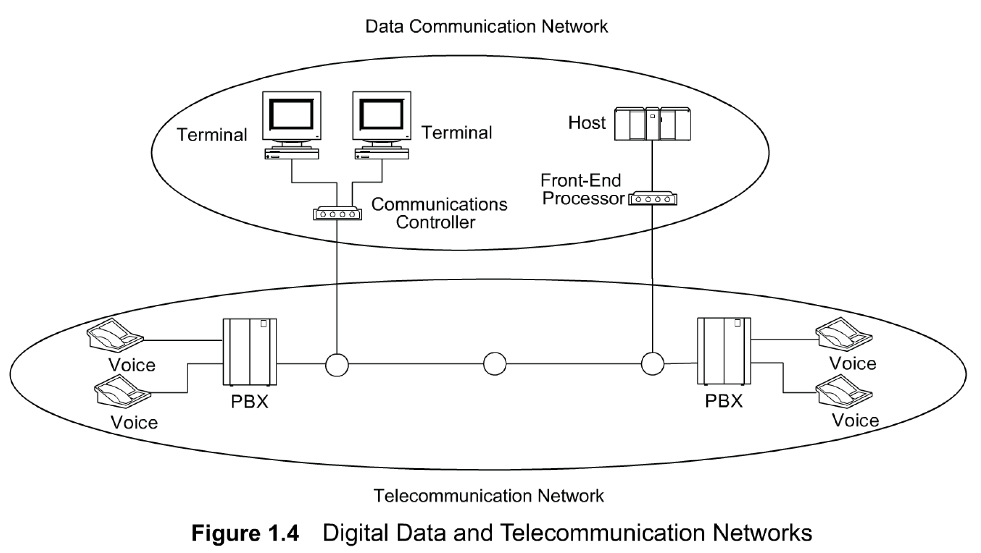
Chapter 1 Data Communications and NM Overview
Migration to Digital Technology
Notes
Analog transmission migrated to digital transmission
Analog sources converted to digital signals
CPE (Customer Premises equipment) included digital PBX (Private Branch Exchanges)
Analog bandwidth hierarchy migrated to synchronous digital hierarchy
Notes:
*

Slide 14
Chapter 1
IBM SNA Architecture
Notes
IBM System Network Architecture (SNA) is a major step in network architecture
SNA is based on multitude of (dumb) terminals accessing a mainframe host at a remote location
1-7

Slide 15
Chapter 1
DCE with LAN
DCE.. Distributed Computing Environment
Notes
Driving technologies for DCE:
Desktop processor
LAN
LAN - WAN network
Network Management: Principles and Practice
© Mani Subramanian 2000
1-8

Slide 16
Chapter 1
LAN-WAN Network
Notes
Major impacts of DCE:
No more monopolistic service provider
No centralized IT controller
Hosts doing specialized function
Client/Server architecture formed the core of DCE network
1-9

Slide 17
Chapter 1
Client/Server Model
Request
Response
Notes
Post office analogy; clerk the server, and the customer the client
Client always initiates requests
Server always responds
Notice that control is handed over to the receiving entity.
Network Management: Principles and Practice
© Mani Subramanian 2000
1-10

Slide 18
Chapter 1
Client/Server Examples
1-11

Slide 19
Chapter 1
TCP/IP Based Networks
TCP/IP is a suite of protocols
Internet is based on TCP/IP
IP is Internet protocol at the network layer level
TCP is connection-oriented transport protocol and ensures end-to-end connection
UDP is connectionless transport protocol and provides datagram service
Internet e-mail and much of the network mgmt. messages are based on UDP/IP
The Internet Control Message Protocol (ICMP) part of TCP/IP suite
Notes
Network Management: Principles and Practice
© Mani Subramanian 2000
1-12

Slide 20
Internet Configuration
Chapter 1
Notes
Walk through the scenario of e-mail from Joe to Sally
1-13

Slide 21
Architecture, Protocols and Standards
Communication architecture
Modeling of communication systems, comprising
functional components and
operations interfaces between them
Communication protocols
Operational procedures
intra- and inter-modules
Communication standards
Agreement between manufacturers on protocols of communication equipment on
physical characteristics and
operational procedures
Notes
Examples: (Students to call out)
Network Management: Principles and Practice
© Mani Subramanian 2000
1-14

Slide 22
Communication Architecture
Notes
Inter-layer interface: user and service provider
Peer-layer protocol interface
Analogy of hearing-impaired student
Role of intermediate systems
Gateway: Router with protocol conversion as gateway to an autonomous network or subnet
1-15

Slide 23
OSI Reference Model
Chapter 1
Notes
Importance of the knowledge of layer structure in NM
Network Management: Principles and Practice
© Mani Subramanian 2000
1-16

Slide 24
OSI Layers and Services
Chapter 1
Notes
Importance of services offered by different layers and the protocol conversion at different layers in NM
1-17

Slide 25
Chapter 1
PDU Communication Model
Notes
What is the relevance of PDU model in NM?
Protocol Data Unit (PDU) has the following meanings:
Information that is delivered as a unit among peer entities of a network and that may contain control information, such as address information, or user data.
1-18

Slide 26
Gateway
Chapter 1
Notes
cc: mail from a station in Novel IPX network to an Internet station with SMTP e-mail
Network Management: Principles and Practice
© Mani Subramanian 2000
1-19

Slide 27
SNA, OSI, and Internet
Chapter 1
Notes
Similarity between SNA and OSI
Simplicity of Internet; specifies only layers 3 and 4
Integrated application layers over Internet
Commonality of layers 1 and 2 - IEEE standard
1-20

Slide 28
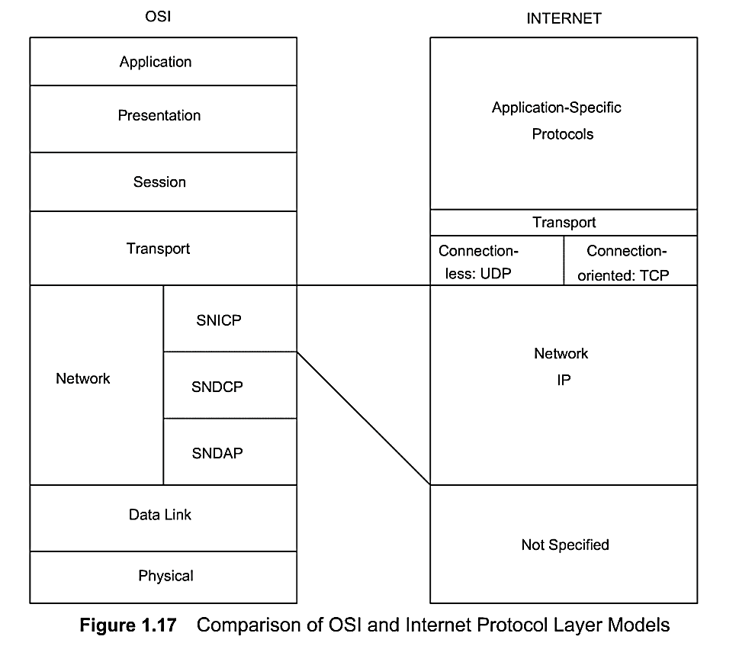
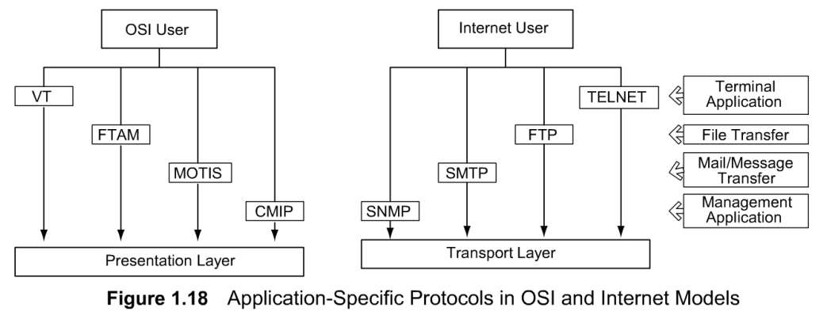
OSI, and Internet
The Internet model does not specify the two lower layers although it is obvious that they use distributed LAN and WAN configurations. Application layers are combined into application-specific protocols.
Figure 1.18 shows a comparison of four common application-specific protocols in OSI and Internet models.
Internet user OSI user
Telnet Virtual Terminal
File Transfer Protocol File Transfer Access & Mgmt.
Simple Mail Transfer Message-oriented Text Protocol Interchange Standard
Simple Network Common Management Management Protocol Information Protocol

Slide 29
Application Protocols
Chapter 1
Notes
Internet user OSI user
Telnet Virtual Terminal
File Transfer Protocol File Transfer Access & Mgmt.
Simple Mail Transfer Message-oriented Text Protocol Interchange Standard
Simple Network Common Management Management Protocol Information Protocol
Network Management: Principles and Practice
© Mani Subramanian 2000
1-21

Slide 30
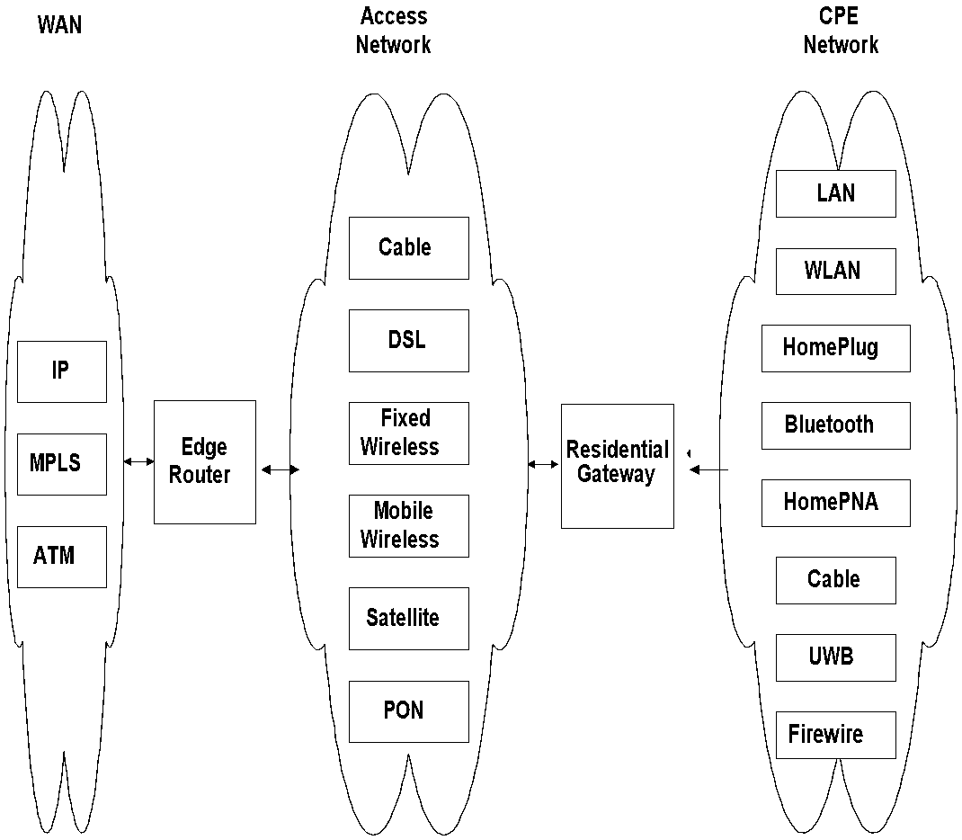
Chapter 1 Data Communications and NM Overview
Broadband Network
Figure 1.19 Broadband Network Segments and Technologies
Notes
Network Management: Principles and Practice
© Mani Subramanian 2010
*
Notes:
*

Slide 31
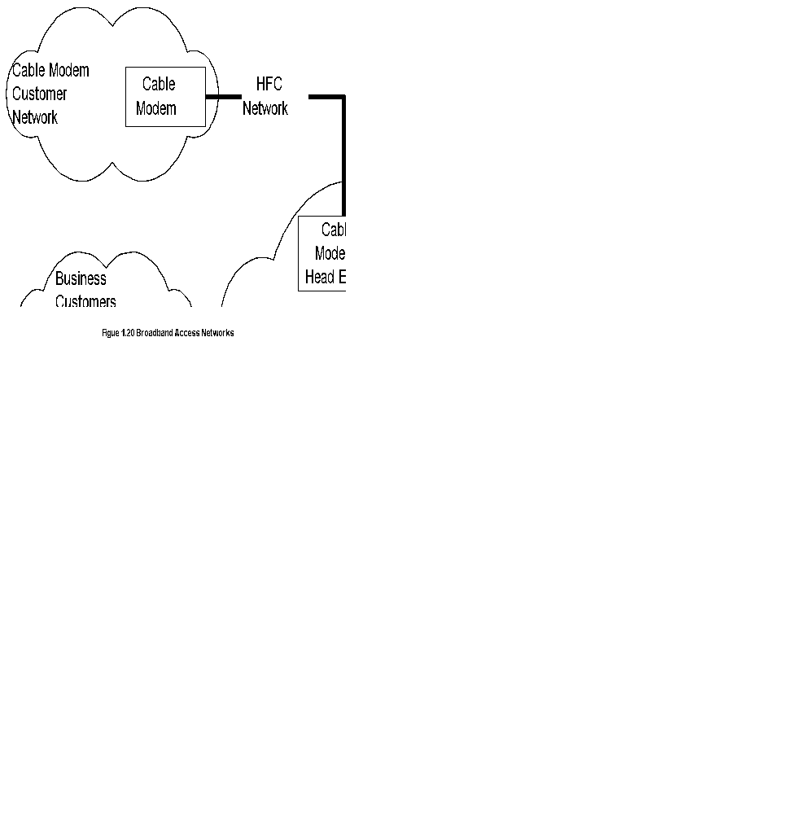
Chapter 1 Data Communications and NM Overview
Broadband Access Networks
Notes
Network Management: Principles and Practice
© Mani Subramanian 2010
*
Notes:
*

Slide 32
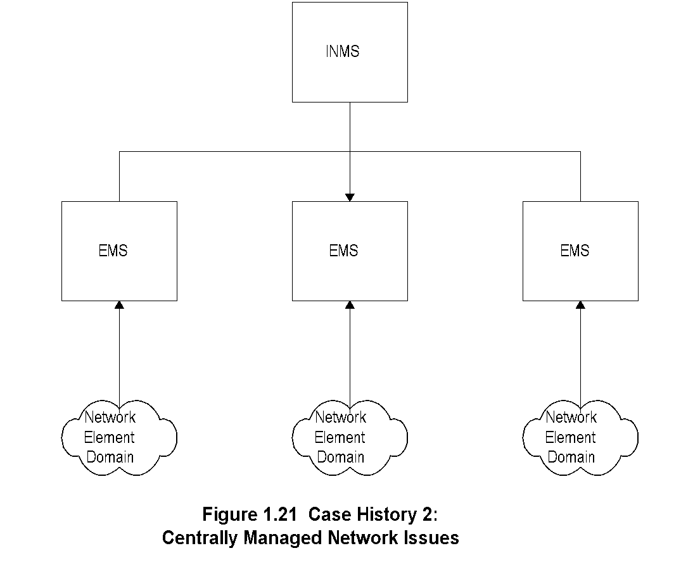
Chapter 1 Data Communications and NM Overview
Centrally Managed Network Issues
Notes
Network Management: Principles and Practice
© Mani Subramanian 2010
*
Notes:
*

Slide 33
NM Case Histories
Chapter 1
The case of the Footprint
Case of the crashing bridge
1-22

Slide 34
Common
Network Problems
Chapter 1
Loss of connectivity
Duplicate IP address
Intermittent (interrupted) problems
Network configuration issues
Non-problems
Performance problems
Notes
Network Management: Principles and Practice
© Mani Subramanian 2000
1-23

Slide 35
Challenges of
IT Managers
Chapter 1
Reliability
Non-real time problems
Rapid technological advance
Managing client/server environment
Scalability
Troubleshooting tools and systems
Trouble prediction
Standardization of operations - NMS helps
Centralized management vs. “sneaker-net”
Notes
Network Management: Principles and Practice
© Mani Subramanian 2000
1-24

Slide 36
1.9 - NETWORK MANAGEMENT:
GOALS, ORGANIZATION, AND FUNCTIONS
Network Management can be defined as Operations, Administration, Maintenance, and Provisioning (OAMP) of network and services.
The Operations group is concerned with daily operations in providing network services.
The network Administration is concerned with establishing and administering overall goals, policies, and procedures of network management.
The Installation and Maintenance (I&M) group handles functions that include both installation and repairs of facilities and equipment.
The Provisioning involves network planning and circuit provisioning, traditionally handled by the Engineering or Provisioning department.
We will describe each of these functions in this section. Although we continue to use the terminology of network management, in the modern enterprise environment this addresses all of IT and IT services.
Provisioning supply with equipment

Slide 37
1.9.1 Goal of Network Management
The goal of network management is to ensure that the users of network are provided IT services with a quality of service that they expect. Toward meeting this goal, the management should establish a policy to either formally or informally contract an service level agreement SLA with users.
From a business administration point of view, network management involves strategic and tactical planning of engineering, operations, and maintenance of network and network services for current and future needs at minimum overall cost. There needs to be a well-established interaction between the various groups performing these functions.
Figure 1.22 presents a top-down view of network management functions.
It comprises three major groups: (i) network and service provisioning, (ii) network and service operations, and (iii) network I&M. It is worth considering the different functions as belonging to specific administrative groups, although there are other ways of assigning responsibilities based on local organizational structure.
Network provisioning is the primary responsibility of the Engineering group.
The Customer Relations group deals with clients and subscribers in providing services planned and designed by the Engineering group.
Network I&M is the primary responsibility of the Plant Facilities group.
Interactions between the groups are shown in Figure 1.23. Normal daily operations are the function of the Network Operations group, which controls and administers a NOC. This is the nerve center of network management operations.
The functions of NOC are primarily concerned with network operations; its secondary responsibilities are network provisioning and network I&M. The associated service operations are handled by a subscriber operation center (SOC) and customer relations management (CRM).
Our focus here is on network operations center (NOC).

Slide 38
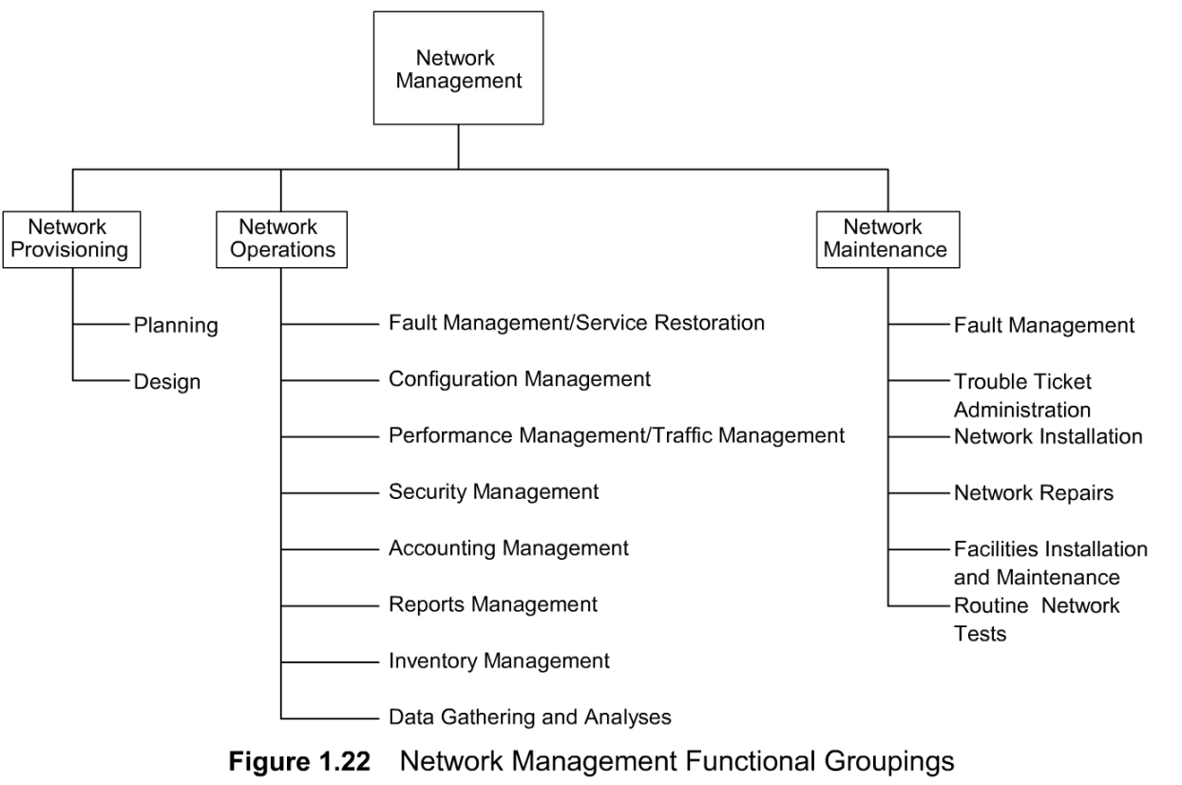
1.9.1 Goal of Network Management (cont.)
Operations
Administration
Maintenance
Provisioning

Slide 39
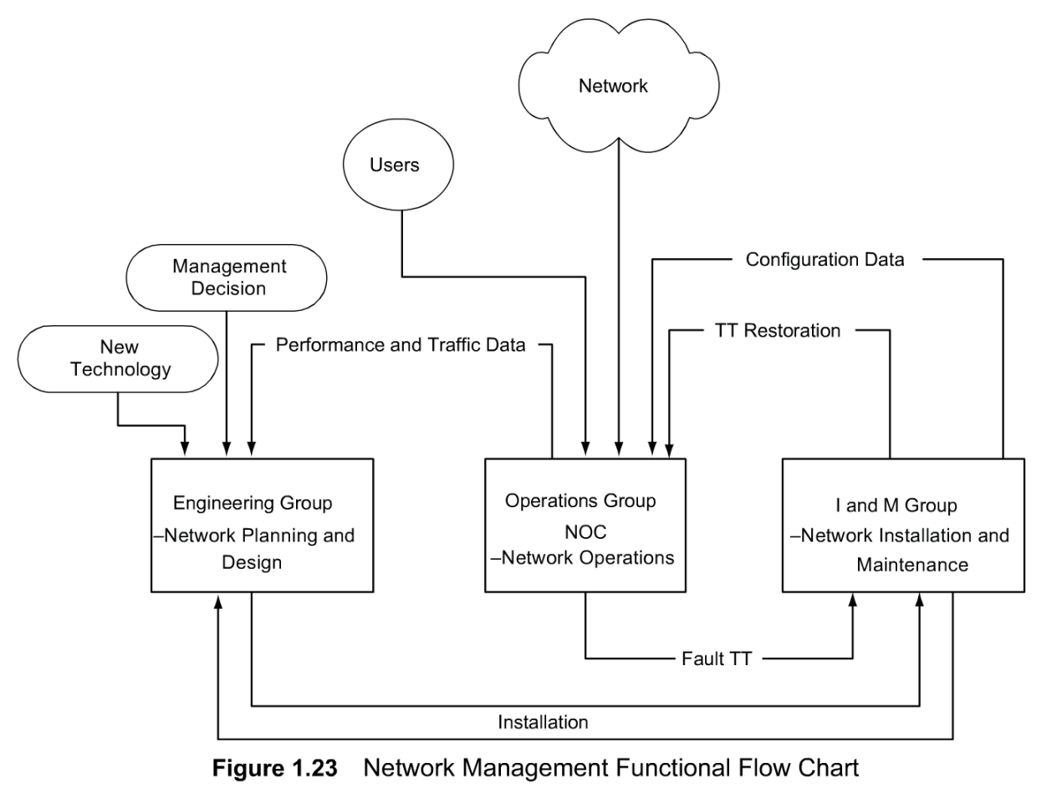
1.9.1 Goal of Network Management (cont.)
NM Functional Flow Chart

Slide 40
1.9.2 Network Provisioning
Network Provisioning consists of network planning and design and is the responsibility of the Engineering group.
The Engineering group keeps track of new technologies and introduces them as needed. What is needed and when it is needed are determined from analysis of traffic and performance data provided by the network operations. New or modifications to network provisioning may also be initiated by management decisions.
Planning and efficient use of equipment can be achieved with good inventory management of current and future modifications of network configuration by the Network Provisioning group.
Network management tools are helpful to the Engineering group in gathering statistics and studying trends in traffic patterns for planning purposes. Automated operations systems help in the design of circuits and measuring the performance tune-up.

Slide 41
1.9.3 Network Operations and NOC
The functions of network operations listed in Figure 1.22 are administered by the NOC. They are concerned with daily operations of the network and providing network services. ISO has defined five OSI network management applications, which are fault, configuration, performance, security, and account management. They are also responsible for gathering statistics and generating reports for management, system support, and users. NMS and tools are a necessity for NOC operations. They are used in various management applications described below:
Fault Management/Service Restoration: Whenever there is a service failure, it is NOC's responsibility to restore service as soon as possible. This involves detection and isolation of the problem causing the failure, and restoration of service. In several failure situations, the network will do this automatically. This network feature is called self-healing. In other situations, NMS can detect failure of components and indicate with appropriate alarms. Restoration of service does not include fixing the cause of the problem. That responsibility usually rests with the I&M group. A trouble ticket is generated and followed up for resolution of the problem by the I&M group. Trouble Ticket Administration: Trouble ticket administration is the administrative part of fault management and is used to track problems in the network. All problems, including non-problems, are to be tracked until resolved. Periodic analysis of the data, which are maintained in a database, is done to establish patterns of the problems for follow-up action.
Configuration Management: There are three sets of configuration of the network. One is the static configuration and is the permanent configuration of the network. However, it is likely that the current running configuration, which is the second, could be different from that of the permanent configuration. Static configuration is one that the network would bring up if it is started from an idle status. The third configuration is the planned configuration of the future when the configuration data will change as the network is changed. NOC has a display that reflects the dynamic configuration of the network and its status.
The status of the network is displayed by a NMS and indicates any failure of components of the network, as well as the traffic pattern and performance. Any configuration changes needed to relieve temporary congestion in traffic are made by NOC and are reflected in the dynamic display at NOC.

Slide 42
1.9.3 Network Operations and NOC (cont.)
Performance Management: Data need to be gathered by NOC and kept updated in a timely fashion in order to perform some of the above functions, as well as tune the network for optimum performance. This is part of performance management. Network statistics include data on traffic, network availability, and network delay. Traffic data can be captured based on volume of traffic in various segments of the network. They can also be obtained based on different applications such as Web traffic, email, and network news, or based on transport protocols at various layers such as TCP, UDP, IP, IPX, Ethernet, TR, FDDI, etc. Traffic statistics are helpful in detecting trends and planning future needs. Performance data on availability and delay are useful for tuning the network to increase the reliability and to improve its response time.
Security Management can cover a very broad range of security. It involves physically securing the network, as well as access to the network by users. Access privilege to application software is not the responsibility of NOC unless the application is either owned or maintained by NOC. A security database is established and maintained by NOC for access to the network and network information. There are other aspects of security management such as firewalls and cryptography, which will be introduced later in Chapter 1 1.
Accounting Management administers cost allocation of the usage of network. Metrics are established to measure the usage of resources and services provided.
Since the network consists of components manufactured by multiple vendors, commonality in the definition and relationship of component attributes is needed. This is defined by Management Information Base (MIB), which we will discuss in Part II. Some of the data acquisition has to be manual (because of legacy systems), but most data can and should be acquired in an automated mode. The SNMP is the most popular protocol to acquire data automatically using protocol- and performance-analyzing tools.
As part of implementing the above standards, we need to ensure that adequate reports are generated and distributed to relevant personnel. There are, in general, three classes of reports: systems, management, and user. System reports are needed for network operations to track activities. Management reports go to the managers of network management group to keep them informed about the activities and performance of NOC and the network. User reports are distributed to users on a periodic basis or are available on-line to let them know the status of network performance.

Slide 43
1.9.4 Network Installation and Maintenance
The Network I&M group takes care of all activities of installation and maintenance of equipment and transmission facilities. This group is the service arm of the Engineering group for installation and fixing troubles for network operations. The group works closely with the Help Desk in responding to the problems reported from the field.
Having introduced what network management is from an operations, administration, maintenance, and planning viewpoint, let us next consider the architecture and organization of an NMS.

Slide 44
1.10 NETWORK MANAGEMENT ARCHITECTURE AND ORGANIZATION
We need to distinguish at the outset the difference between network management and network system and service management.
We can generalize system and service management as the management of systems and system resources in the network and services offered by the network.
Network management is concerned with network resources such as hubs, switches, bridges, routers, and gateways, and the connectivity among them via a network. It also addresses end-to-end connectivity between any two processors (not application processes) in the network.
As we saw in Section 1.1,a network consists of network components and their interconnection. Each vendor, who manufactures a network component or a set of network components, is best qualified to develop an NMS to manage that product or set of products. This involves getting data from each instance of that component in the network to one or more centralized locations and displaying their status on an NMS; for example, failure of a bridge. This would set up an alarm in the NMS to alert operations personnel of the failure. This would enable operations personnel to follow up on the problem and restore service, even before the user calls in a complaint.
There is need for an NMS to manage all the components that are connected to a network. Again, it is relatively simple for a vendor to develop an NMS to manage a network comprising only their components. However, a user, such as a global corporation, buys components from many different vendors, and the information systems manager of the corporation has the responsibility of maintaining the network of all vendor components. This might require the installation of multiple NMSs for an enterprise or an NMS that can manage multiple vendor components of a network.
Thus, common management system, as well as the integration of different management systems and the interoperability between them, has played a major role in the network management arena.
Standards organizations and industrial communities have established standards for this purpose, which are still evolving. The two major management standards are the Internet developed by the Internet Engineering Task Force (IETF) and OSI developed by the ISO.

Slide 45
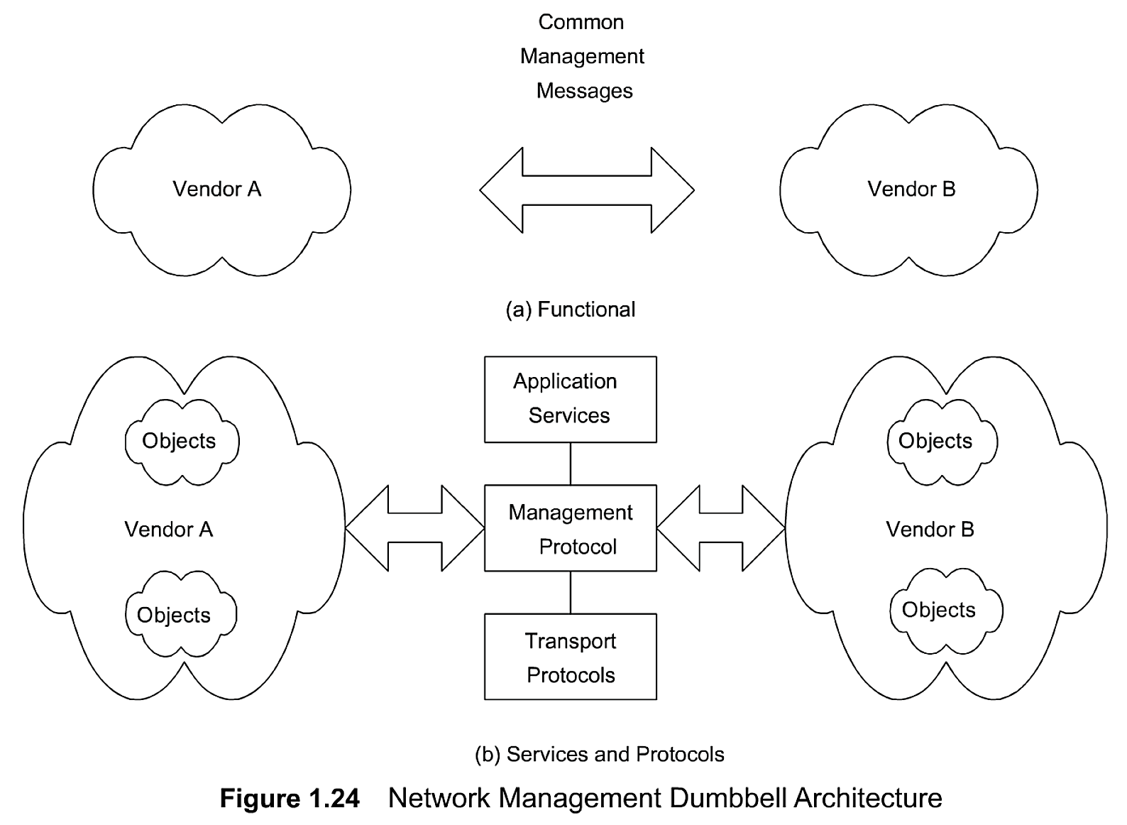
1.10 NETWORK MANAGEMENT ARCHITECTURE AND ORGANIZATION (cont.)
Network management dumbbell architecture for interoperability is shown in Figure 1 .24(a) where two vendor systems A and B exchange common management messages. The messages consist of management information data (type, id, and status of managed objects, etc.) and management controls (setting and changing configuration of an object). The protocols and services associated with dumb bell architecture are presented in Figure 1.24(b). Application services are the management-related applications such as fault and configuration management. Management protocols are CMIP for the OSI model and SNMP for the Internet model. Transport protocols are the first four OSI layers for the OSI model and TCP/IP over any of the first two layers for the Internet model.
Dumbbell Architecture
Message exchange between NMSs managing different domains

Slide 46
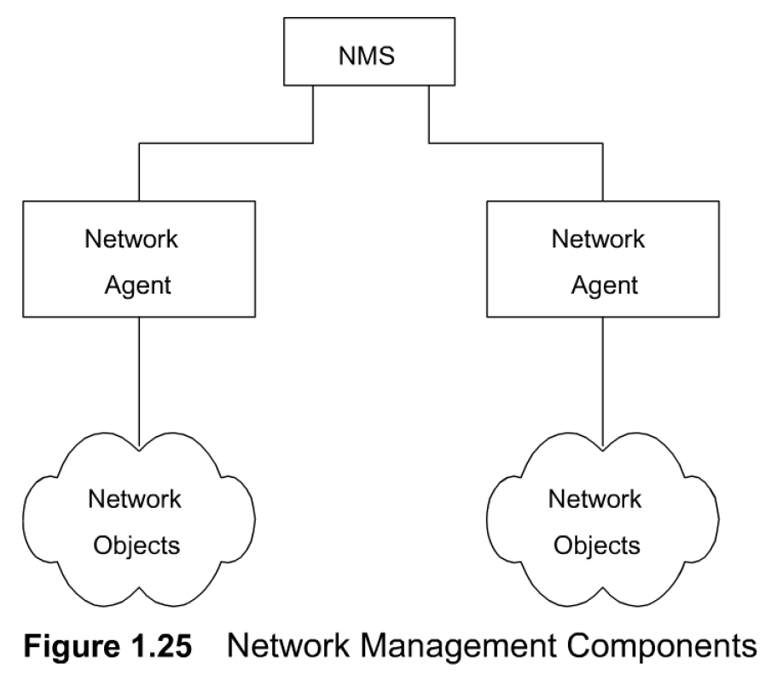
1.10 NETWORK MANAGEMENT ARCHITECTURE AND ORGANIZATION (cont.)
Figure 1.25 models a hierarchical configuration of two network agents monitoring two sets of managed objects. The agent could be an embedded agent in a network element or an EMS communicating with agents embedded in the network elements. An NMS is at the top of the hierarchy.
Each network agent monitors its respective objects. Either in response to a polled query from the NMS or triggered by a local alarm, the agent communicates to the NMS the relevant data.

Slide 47
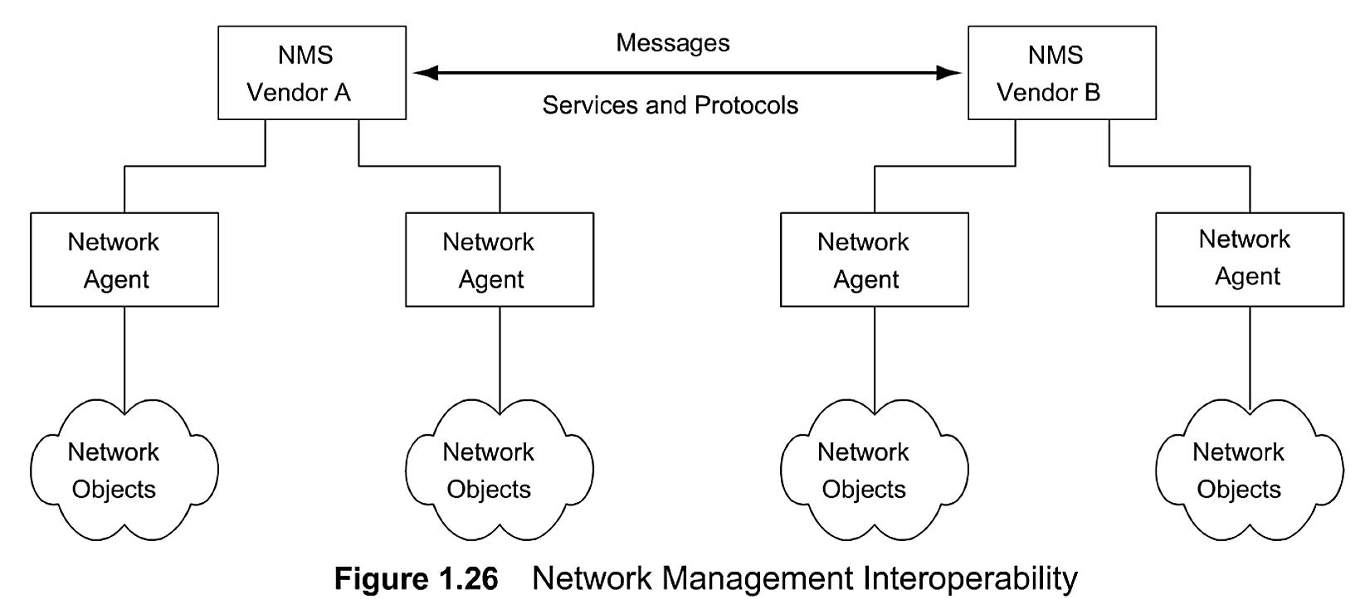
1.10 NETWORK MANAGEMENT ARCHITECTURE AND ORGANIZATION (cont.)
Peer networks can communicate network management messages and controls between each other, as shown in Figure 1.26. An example where such a configuration could be implemented would be two NMSs associated with two telecommunication networks belonging to two network service providers; for example, an interexchange carrier and a local access provider. As the two NMSs communicate with each other, each NMS can superimpose the data from the other and present an integrated picture to the network administrator.
We want to make one final note before we leave this section. Some of the issues associated with the management of telecommunication network by the telecommunication service providers are unique and involve more than just management of networks. This has given birth to the Telecommunication Management Network (TMN) framework and related standards. We will address these in Chapter 1 0.
Interoperability التشغيل التفاعلي

Slide 48
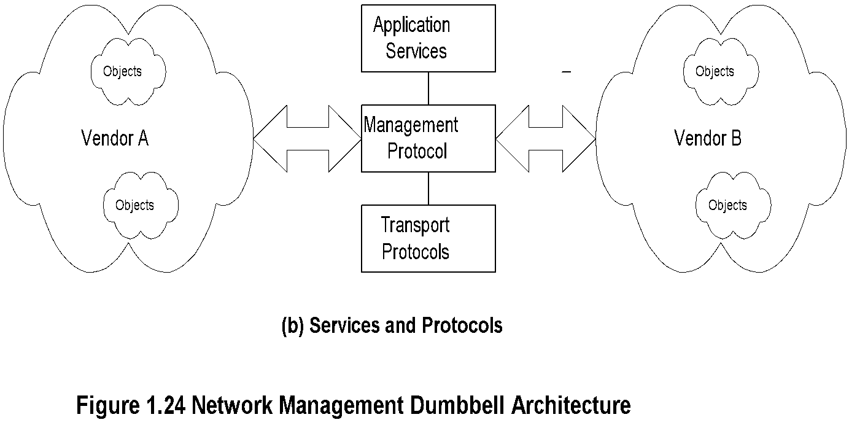
Chapter 1 Data Communications and NM Overview
Dumbbell Architecture
Notes
Message exchange between NMSs managing different domains
Notes:
*

Slide 49
Chapter 1
NM Components
Notes

Slide 50
Interoperability التشغيل التفاعلي
Chapter 1
Notes
Message exchange between NMSs managing different domains
1-28

Slide 51
1.11 NETWORK MANAGEMENT PERSPECTIVES
As we said earlier, the NMS primarily manages the networks that transport information. However, from a user's perspective, networks are means to an end, namely to have access to information across the networks. Thus, the users' needs require a total solution to manage the networks, system resources, and applications that run on systems. Applications could be specific user applications, or general-purpose servers such as file servers, database servers, and DNSs. Software products have since been developed to address such system-wide solutions.
An IT manager is interested in more than managing networks, systems, and applications. He or she would like to automate other functions such as back up of databases and programs, downloading of software updates from a central location, and a host of other support functions. These are required to run an IT operation efficiently and in a cost-effective manner.
Another area of system management is logging and archiving of events. This is illustrated by a case history when the system performance during normally slow activity time at night was poor. Further probing the system resources indicated that the system was busy with processes being executed from outside the institution. The system had been "compromised," i.e., had been broken into. The intruder could manipulate the normal system resource tools so as to hide the intruder programs. The intruder was finally discovered from the archival system log.
Solutions to the total IT services are currently being offered by commercial vendors. We will discuss them along with network and system management tools and systems in Part IIIof the book. We will present here a high-level view of some of the alternate perspectives of the broad aspects of network management.

Slide 52
1.11 NETWORK MANAGEMENT PERSPECTIVES (cont.)
1.11.1 Network Management Perspective
Domains: The network management overview given so far in the chapter can be perceived as management of a domain. The domain can be any of a selected group of parameters having common attributes.
Thus, a geographical domain refers to the subdivisions of a large geographical region. For example, in India the telecommunication administration is divided into circles, and each circle maintains its own telecommunication network.
Another classification of a domain can be based on vendor products. Thus, we could have different vendors' management systems managing their respective products. A third perspective of looking at domains can be from the technology perspective. For example, IP-based products, telecommunication products, broadband communication products, and digital transport products such as SDH could each define a domain managed by a separate NMS, as well as a different administrative group.
Protocols: Network management can be perceived from the protocol used to manage the network such as Internet-based SNMP and OSI-based Common Management Information Protocol/Common Management Information Service Element (CMIP/CMISE). Traffic use of various protocols at each protocol layer can be monitored.
Network and Transmission Technologies: An end-to-end network system could be viewed as comprising multiple network technologies traversing different transmission media and carrying information in different transmission modes, each managed from a different network management perspective. Thus, an end-to-end communication, which can be represented as a logical circuit, could be made up of network elements comprising IP-based routers and ATM-based switches. It can traverse globally through coaxial cable in an access network, wireless transmission over continents, fiber optic cable over land on a WAN, and twisted copper wire at home. The transmission mode could be digital TDM, or ATM, or a broadband access mode. An integrated NMS is used to manage end-to-end availability of a circuit that deploys multivendor and multi technology network elements.

Slide 53
1.11 NETWORK MANAGEMENT PERSPECTIVES (cont.)
1.11.2 Service Management Perspective
The network is used to provide service to customers and consequently what needs to be managed are the services. The real concern of service providers is more about service management. Providing quality of service to satisfy the customers' needs requires network management. However, while network management focuses on the physical network, service management focuses on services offered over the network and those services meeting customer needs and satisfaction. Various quality of service (QoS) parameters are defined and an SLA is reached between the service provider and the customer. There are several OSSs that provide different types of service management.
Communication services can be offered as public switched network services, Internet services, virtual private network, real-time interactive audio and video services, and others too numerous to list.
Computing services are offered to clients using applications running on servers. These servers and applications running on them need to be managed centrally by the service provider or enterprise that owns them. This management is also known as enterprise management. It monitors the health of system resources, as well as the applications that run on them. There are managed service offerings available to manage multiple enterprise networks from a common management facility.

Slide 54
1.11 NETWORK MANAGEMENT PERSPECTIVES (cont.)
1.11.3 OSS Perspective
While the EMS, NMS, and enterprise management system are designed to manage the network and network resources, OSSs support the operation of network and service management systems. In Section l.9 we described the supporting functions of networking needed to provide communication services as operations, administration, maintenance, and provisioning (OAMP).
Provisioning System: The logical and physical network has to be provisioned to provide the desired service to the customer. An OSS, provisioning management system, does this function using several other OSSs such as the inventory management system, the service order system, and the element and NMSs. Provisioning management includes circuit provisioning, service provisioning, and network provisioning.
Inventory Management System includes inventory of equipment and facilities. We can generalize equipment as active components forming nodes of a network and facilities as passive components linking the nodes.
Customer Relations Management (CRM) operation support system manages complaints reported by the customers. A proactive approach to CRM is the service provider calling the customer on detecting a service outage indicated by NMS.
Trouble Ticket and Work Force Management manages the troubles detected by the NMS and generates work order in the Work Force Management System. Various OSSs help with the remote testing, either on-demand or automated, in installation and maintenance.
IP Telecommunication Application Management: The traditional analog services of voice and video are now offered as digital services. Such services as voice-over-IP and video-over-IP applications require not only management of data, but also connection management. Sessions that are equivalent to a circuit need to be established and managed.
1.11.4 e-Business Management
The e-business management and privacy requirements arc associated with e-commerce applications.
This includes application management in Internet retail activities, as well as banking automated teller machines.

Slide 55
1.12 NMS PLATFORM
NMSs and tools are available in various platforms—hardware and operating system. Popular high-end systems are housed on UNIX-based servers. Low-end NMSs run either on Windows or Linux-based platforms.
Most high-end NMSs are equipped with remote client capability and can be accessed either via Java client or Web browser. Client platforms are either Windows or UNIX based.
Common troubleshooting and monitoring of network element parameters could be done by using simple networking and network management tools. These are part of TCP/IP stack. For example, network connectivity could be tested using ping and trace route commands in UNIX and tracer in Microsoft Windows.

Slide 56
Chapter 1 Data Communications and NM Overview
Network Management Perspectives
Network Management
Service Management
Service and Network Provisioning
Application Management
e-Commerce Management
Inventory Management
Integrated Management
Business Management
Information Management
Management Protocols
Management Technologies
Notes
Network Management: Principles and Practice
© Mani Subramanian 2010
*
Notes:
*

Slide 57
Chapter 1 Data Communications and NM Overview
Infrastructure Perspective
Domains
Protocols
Technologies
Transmission Media
Transmission Modes
Service Functions
Notes
Network Management: Principles and Practice
© Mani Subramanian 2010
*
Notes:
*

Slide 58
Chapter 1 Data Communications and NM Overview
Service Perspective
Communication Services
Computing Services
Content Services
IT Services
Application Services
Notes
Network Management: Principles and Practice
© Mani Subramanian 2010
*
Notes:
*

Slide 59
1.12 CURRENT STATUS AND FUTURE OF NETWORK MANAGEMENT
Current NMSs are based on SNMP protocol. Most commercial network components have embedded SNMP agents. Because of the universality of the IP, transport of management information for SNMP management, which is TCP/IP-based, is automatically resolved. In addition, most of the popular host-operating systems come with TCP/IP protocol suite and thus are amenable to SNMP management.
Current NMSs, however, suffer from several limitations. One of the limitations of SNMP-based management system is that values of managed objects should be defined as scalar values. OSI-based management protocol, CMIP, is object oriented. However, it has not been successful due to the complexity of specifications of managed objects and the limitation of large memory in computer systems in the past.
Another limitation of SNMP-based management is that it is a poll-based system. In other words, NMS polls each agent as to its status, or for any other data that it needs for network management. Only a small set of transactions is initiated by a management agent to an NMS as alarms. To detect a fault quickly, or to obtain good statistics, more frequent polling of agents needs to be done by the NMS, which adds to network traffic overhead. There is an alternative solution to this problem, which is deployment of remote monitors as discussed in Chapter 8.
Some of the above constraints in SNMP-based management have been overcome by emerging advanced network management discussed in Chapter 16. Object-oriented technology has reached a matured stage, and the hardware capacity to handle object-oriented stacks is now commercially available. Thus, object-oriented network management is being reconsidered. This has potential application in Telecommunications Management Network discussed in Chapter 10. Network management systems are currently built with object-oriented protocols and schema, such as Common Object Request Broker Architecture (CORBA) protocol and Extended Markup Language (XML) schema.
An active network, which is the direction of next generation network, would include embedded network management applications. Besides the advancement of research and development in network management in standards, protocols, methodology, and new technology, there is considerable activity in management applications, which form the topic of Chapter 1 1 . Of particular significance are event correlation technology in fault management, and secured network and communication in security management.
With the proliferation of the Internet, secured network and communication has become extremely important. Existing management standards do not go far enough in this. However, security management has taken on the role of a special topic in network management. Topics of high interest in this field are firewalls that establish secure networks and cryptography that assure secure communication.
IT itself is exploding and gives rise to new challenges for expanding the horizon of network management. Transport of voice, video, and data is integrated in broadband multimedia services. Broadband multimedia service is based on ATM, IP, and MPLS in a WAN and several emerging access technologies such as HFC, Asymmetric Digital Subscriber Loop (ADSL), and fixed and mobile wireless. Quality of Service in integrated services is important. Managing these new service offerings forms the content of Part IV.
Another re-emerging technology for network management is the wireless technology. This is being widely deployed for WAN, mobile, broadband access, and home networks. Much work on standardization of management of this technology needs to be done in this area.

Slide 60
Chapter 1
Status and Future Trends
Status:
SNMP management
Limited CMIP management
Operations systems
Polled systems
Current Focus:
Object-oriented approach
Service and policy management
Business management
Web-based client management
Future Trends
Web-based management?
XML based management
Network Management: Principles and Practice
© Mani Subramanian 2000
1-29

Slide 61
Summary
We presented in this chapter an overview of data and telecommunication networks, as well as converged networks and how these networks are managed. The telephone network was shown as a model to be followed in accomplishing a reliable, dependable, and quality data communication network. We explained the difference between data communication and telecommunication networks, although this distinction is fast disappearing. Desktop processors and LAN technology have contributed to the client-server distributed computing environment, which has changed the future direction of data communication.
We briefly talked about the Internet and intranet in today's environment. Adoption of standards has played a significant part in the popularity of the Internet. OSI and IPs play an important part in data communication today. We also treated difficulties associated with real-time and non-real-time management of different segments of broadband networks and services. We have presented some practical day-to-day experiences of network managers, including "war stories" to make us realize the importance of network management.
We saw a bird's-eye view of network management and described how network components and networks are managed by network management systems. We extended the concept of network management to managing networks and systems and all of IT services. The future direction of IT management is undergoing changes due to advancements in software and IT. Possible future directions in network management technology were addressed at the end of the chapter.

Slide 62
Test Banks Chapter 1 and 2
1. How many layers does the OSI Reference model have?
a) 5
b) 4
c) 6
d) 7
e) None of the above
2. Which layer of the OSI Reference Model has two sub layers?
a) Physical layer
b) Data links layer
c) Session layer
d) Application layer
e) None of the above
3. Select the correct statement from the following:
a) TCP/IP is a protocol of DECNET
b) TCP/IP is a single protocol
c) TCP/IP is a connectionless protocol
d) TCP/IP is a connection-oriented suite of protocols
e) All of the above are true
4. Select the false statement from the following:
a) a vLAN is based on switched hub technology
b) a vLAN enables stations to be assigned physically
c) a vLAN enables stations to be assigned administratively
d) a vLAN is not restricted by the physical configuration of a LAN
e) All of the above are true
5. Which of the following is a challenge for the management of corporate networks, select the best choice
a) Analysis of networks problems
b) Networks reliability
c) Rapid advance of network technology
d) Networks security
e) All of above

